Slide 1
Today’s Highlights
Master-Slave Flip Flop

Slide 2
Race Round Condition
Conditions for of Race-Around
1. Both JK inputs should be J = 1, K = 1
2. Flip-Flop should be Level-triggered
3. Clock pulse width being longer than the propagation delay.

Slide 3
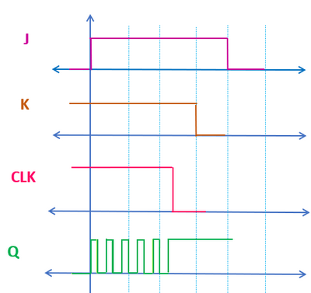
Race Round Condition with Timing Diagram

Slide 4

How to Overcome Said problem
Think About this

Slide 5
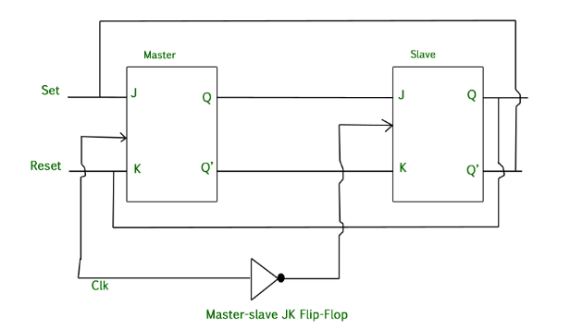
Master Slave JK Flip Flop
Step 1: Block Diagram

Slide 6
QUICK QUIZ (POLL)
Define the problem that is resolved by Master-Slave configuration
A) To reduce the size of the circuit B) To eliminate the race-around condition C) To increase the clock speed D) To enable asynchronous operation

Slide 7
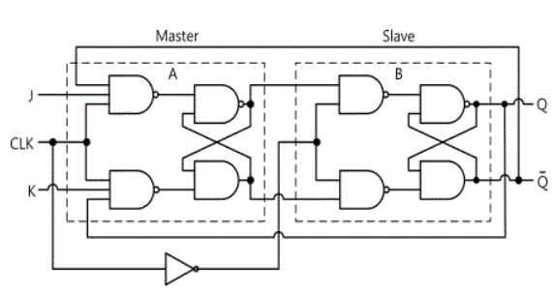
Step 2: Circuit Diagram

Slide 8
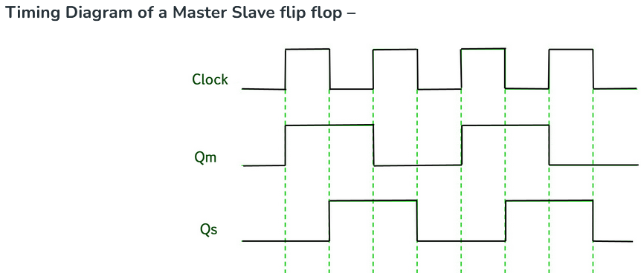
Acting as Master
Acting as Slave

Slide 9
QUICK QUIZ (POLL)
In a Master-Slave JK Flip-Flop, when does the slave flip-flop become active?
A) When the clock is high B) When the clock is low C) On both rising and falling edges of the clock D) When both J and K are 1

Slide 10
QUICK QUIZ (POLL)
Which type of triggering is used in a Master-Slave JK Flip-Flop?
A) Level triggering B) Edge triggering C) Pulse triggering D) None of the above

Slide 11
QUICK QUIZ (POLL)
In a Master-Slave JK Flip-Flop, what happens if J=1J = 1J=1 and K=1K = 1K=1?
A) Output is set to 1 B) Output is reset to 0 C) Output toggles on every clock pulse D) Output remains unchanged

Slide 12
QUICK QUIZ (POLL)
Why is the slave flip-flop called "slave" in a Master-Slave JK Flip-Flop?
A) It generates the clock signal B) It stores the output from the master flip-flop C) It determines the final output state independently D) It synchronizes the master flip-flop

Slide 13
How to design specific Flip Flop with Other FF?
Think About this

